Slide 1
Chapter 7 Concepts
Building Good Spreadsheet Models
Influence Diagrams
Auditing Spreadsheets
What-If Analysis
Data Tables
Goal Seek
Conditional Logic (SUMIF, COUNTIF, AVERAGEIF)
Conditional Formatting
SUMPRODUCT
Quick Analysis and Flash Fill
Vertical Lookup Tables (VLOOKUP)
Calculating NPV
For Next Week:
Finish Excel Intermediate Exercises (on Moodle) and Read Chapter 2
Finish Auditing Spreadsheets Assignment (Lang Drug on Moodle) (May do in teams, if desired. Will not be graded, but individuals with the correct answer earn 5 points extra credit to apply toward the Midterm Exam.)
Complete Ch. 2 H/W Problems: 6, 12, 18, 22, 24, 26

Slide 2
Building Good Spreadsheet Models
The general principles of spreadsheet model design and construction are:
Separate the parameters from the model – This enables the user to update the model parameters without the risk of mistakenly creating an error in a formula.
Document the model and use proper formatting and color as needed - A good spreadsheet model is well documented. Clear labels and proper formatting and alignment facilitate navigation and understanding.
Use simple formulas - Clear, simple formulas can reduce errors and make maintaining the spreadsheet easier. Long and complex calculations should be divided into several cells.

Slide 3
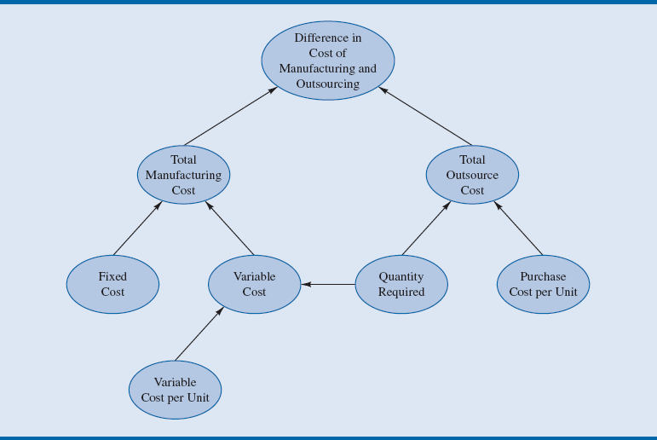
Figure 7.2 - An Influence Diagram for comparing Manufacturing versus Outsourcing cost for Nowlin plastics
Notes:
Figure 7.2. shows expanded influence diagram that includes an outsourcing option.
Note that the influence diagram in Figure 7.1 is a subset of the influence diagram in Figure 7.2.
This modular approach of building an influence diagram for a portion of the problem and then expand it until the total problem is conceptually modeled simplifies the process and reduces the likelihood of error.

Slide 4
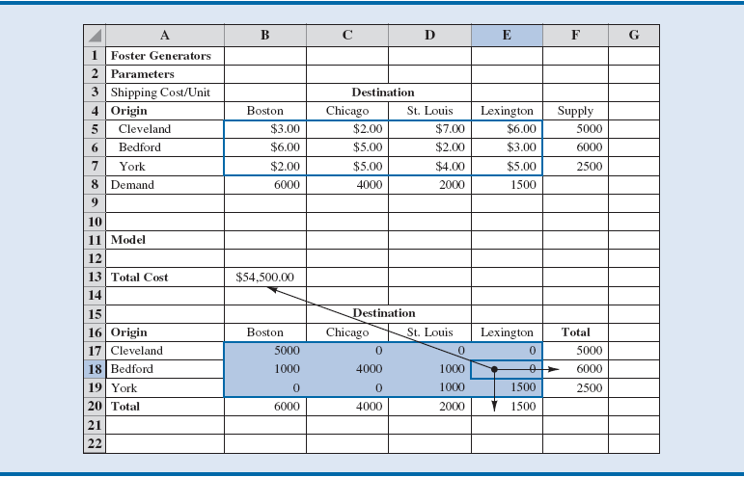
Figure 7.15 - Trace Dependents for the Foster Generators Model
Notes:
An example of Trace Dependents is shown in Figure 7.15. We have selected cell E18, the units shipped from Bedford to Lexington, and clicked on the Trace Dependents button in the Formula Auditing group.
As shown in Figure 7.15, units shipped from Bedford to Lexington impacts the cost function in cell B13, the total units shipped from Bedford given in cell F18, as well as the total units shipped to Lexington in cell E20.
These arrows may be removed by clicking on the Remove Arrows button in the Auditing Tools group.

Slide 5
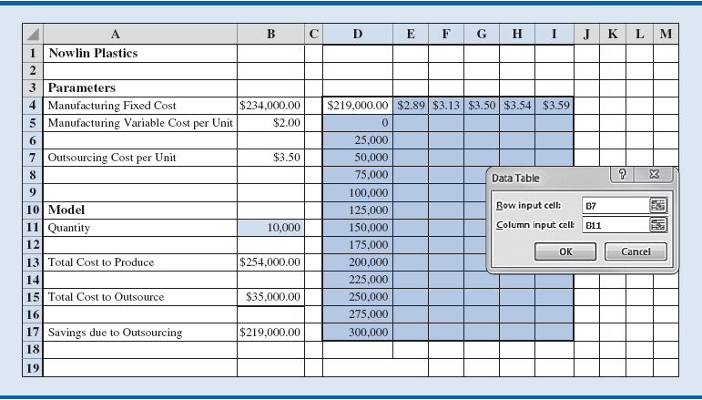
What-If Analysis The Power of Spreadsheet Software
Data Table: Excel tool which quantifies the impact of changing the value of a specific input on an output of interest.
One-way data table: Summarizes a single input’s impact on the output
Two-way data table: summarizes two inputs’ impact on the output.
Notes:
Let us consider how savings due to outsourcing changes as the quantity of Vipers required changes. This should help us answer the question, “For which values of q is outsourcing more cost-effective?”
A one-way data table changing the value of quantity and reporting savings due to outsourcing would be very useful.
We will use the previously developed Nowlin spreadsheet for this analysis.

Slide 6
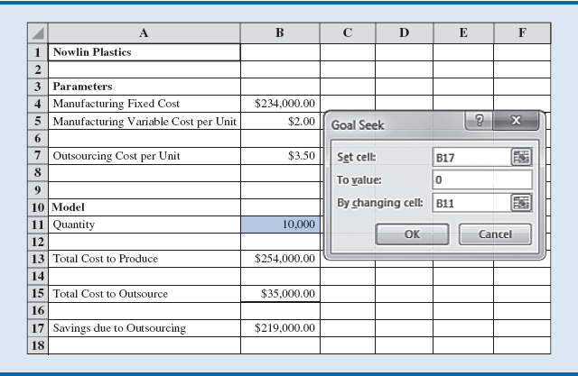
What-If Analysis – Goal Seek
Goal Seek: Excel tool that allows the user to determine the value of an input cell that will cause the value of a related output cell to equal some specified value (the goal).
In a common business case, we want to know the value of the quantity of a product where it becomes more cost effective to manufacture rather than outsource.
Notes:
For example, we see from the table in Figure 7.7 that, for a bid price of $3.50 and some quantity between 150,000 units and 175,000 units, savings due to outsourcing goes from positive to negative.
Somewhere in this range of quantity, the savings due to outsourcing is zero, and that is the point where Nowlin would be indifferent to manufacturing and outsourcing.

